Slide 1
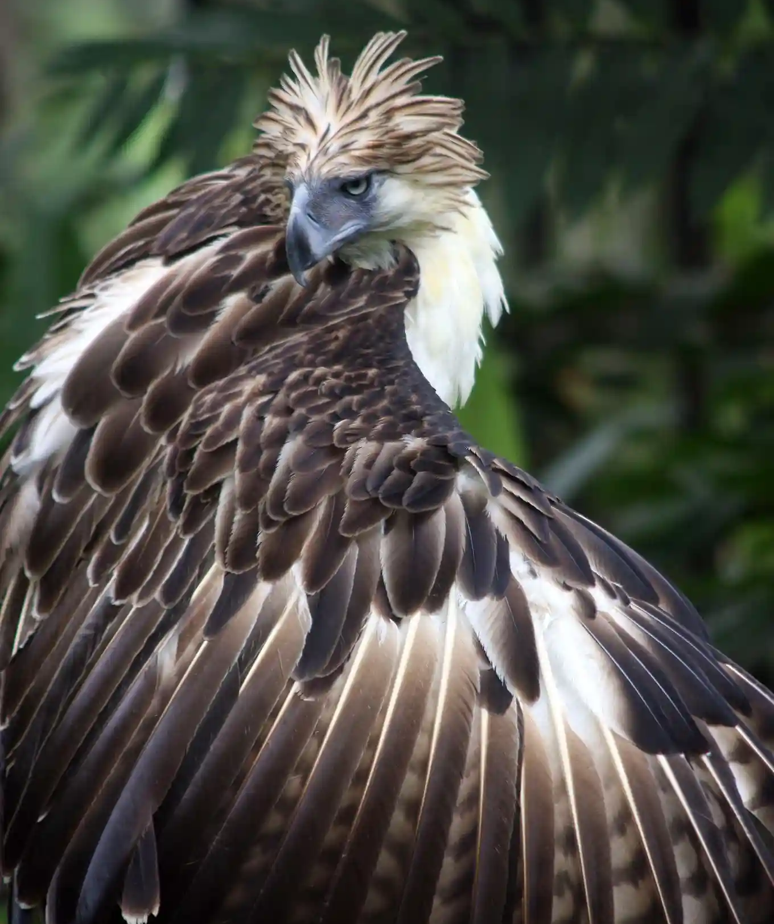
Statistical Analysis of Biological Data
Deon Roos &
Michelle Pinard

Slide 2
Why are you here?

Slide 3
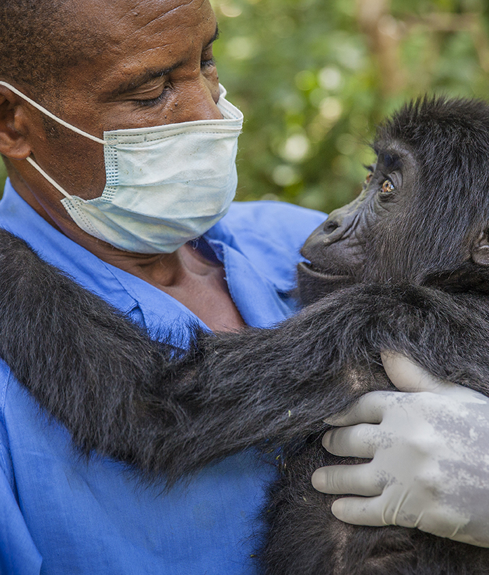
Taking care of gorillas
“Why are they teaching you statistics? Don’t you guys just learn how to do stuff like ‘take care’ of gorillas?”
Comment made to me by a chemistry undergrad
when I mentioned we were learning about P-values

Slide 4
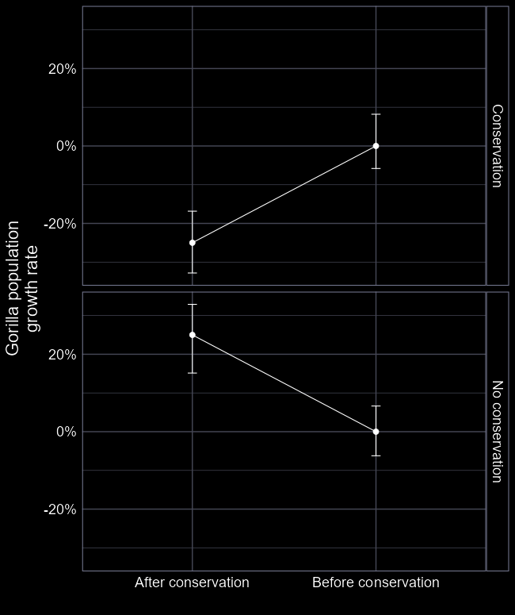
Why are you doing a statistics course?
Statistics is how we merge our questions with our data to give evidence
On their own:
  A question is not evidence
  Data is not evidence
All three parts are crucial for answering questions.
Statistics is how we answer questions.

Slide 5
Phrases I encounter too often

Slide 6
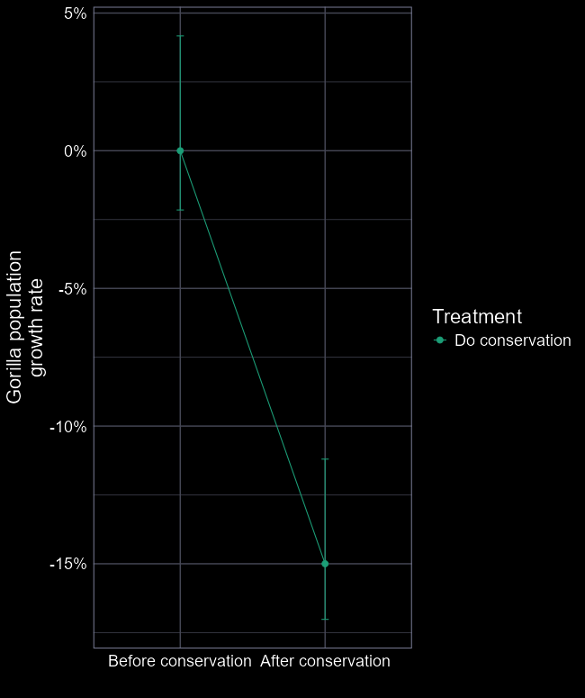
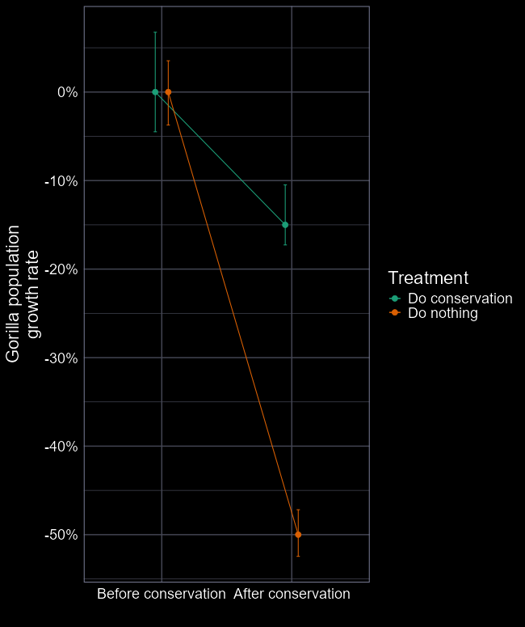
“We’ve analysed it carefully”
Did conservation action improve gorilla growth rate?
  Conservation made a bad situation better
Getting a number out of a model does not make it right.

Slide 7
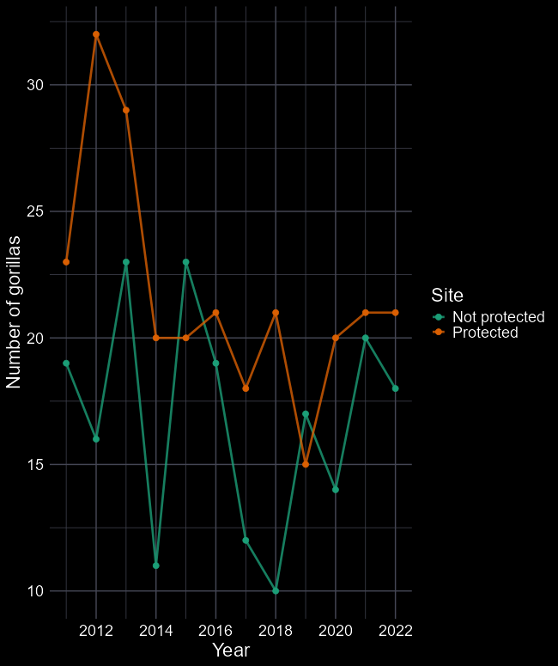
“But I can see it!
Just look at the data!”
Which site has more gorillas?
  They both have 20 gorillas on average
  Fluctuations are random
Humans are excellent at spotting patterns, even when there are no patterns

Slide 8
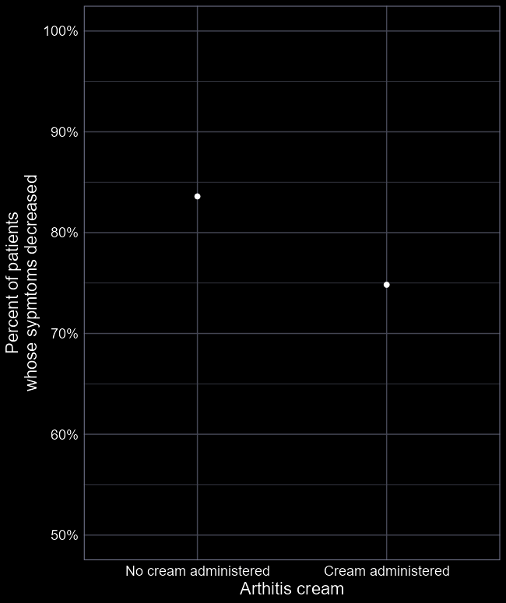
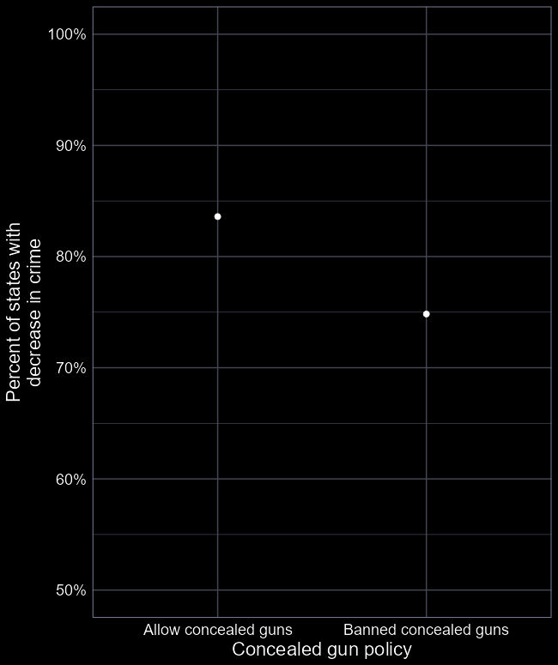
“I’m not biassed;
I’m a scientist”
Does giving cream help arthritis?
  Does banning gun concealment help crime?
Understanding stats can help identify when this is an issue; but doesn’t prevent it.

Slide 9
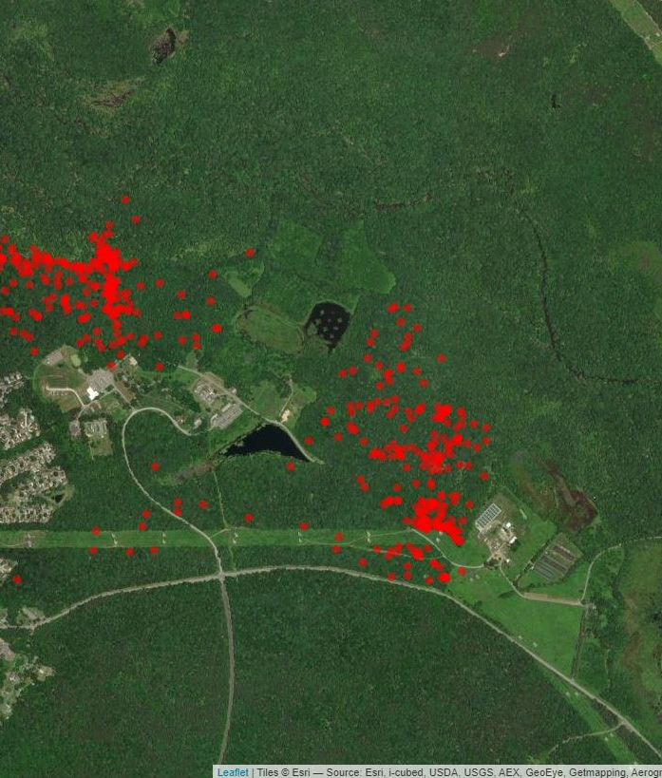
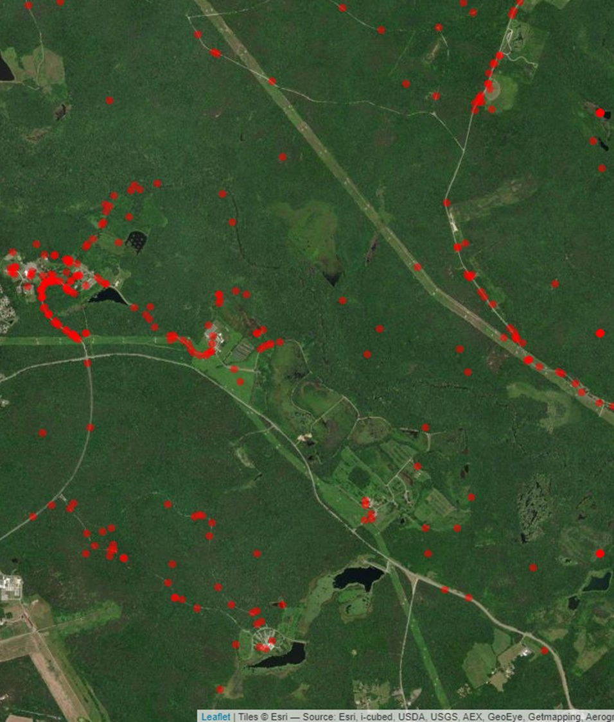
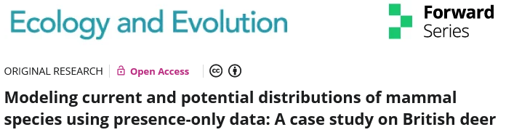
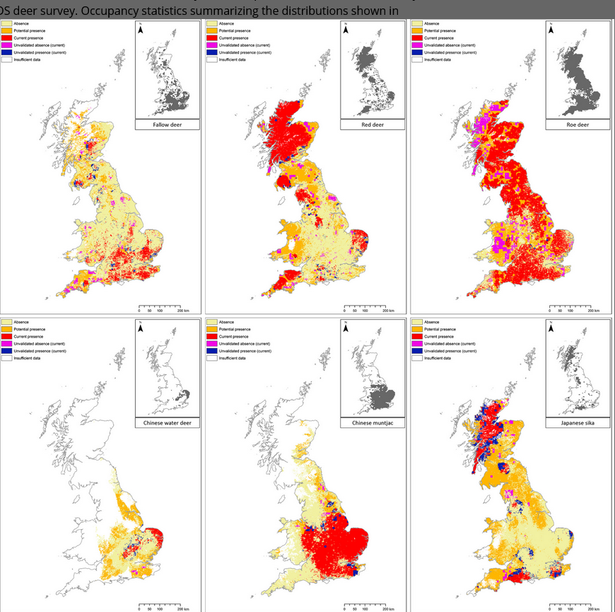
“My data isn’t biased; It’s the best available!”
What sort of habitat do box turtles prefer?
  Box turtles love urban areas and roads
  Except they don’t. That’s just where people walk (and see them).
Decent understanding of statistics needed to prevent this.

Slide 11

The prodigal child
Failed maths twice in high school
Dropped out of University in 2007
Came back to study Zoology @ Aberdeen in 2012
  Didn’t understand stats in undergrad
Started a PhD @ Aberdeen in 2016
  “Graduated” in 2021
Research & Teaching Fellow (a “postdoc”)
Senior Statistical Ecologist for government
Lecturer in Applied Stats
My main “selling point” now is that I’m good at stats

Slide 12
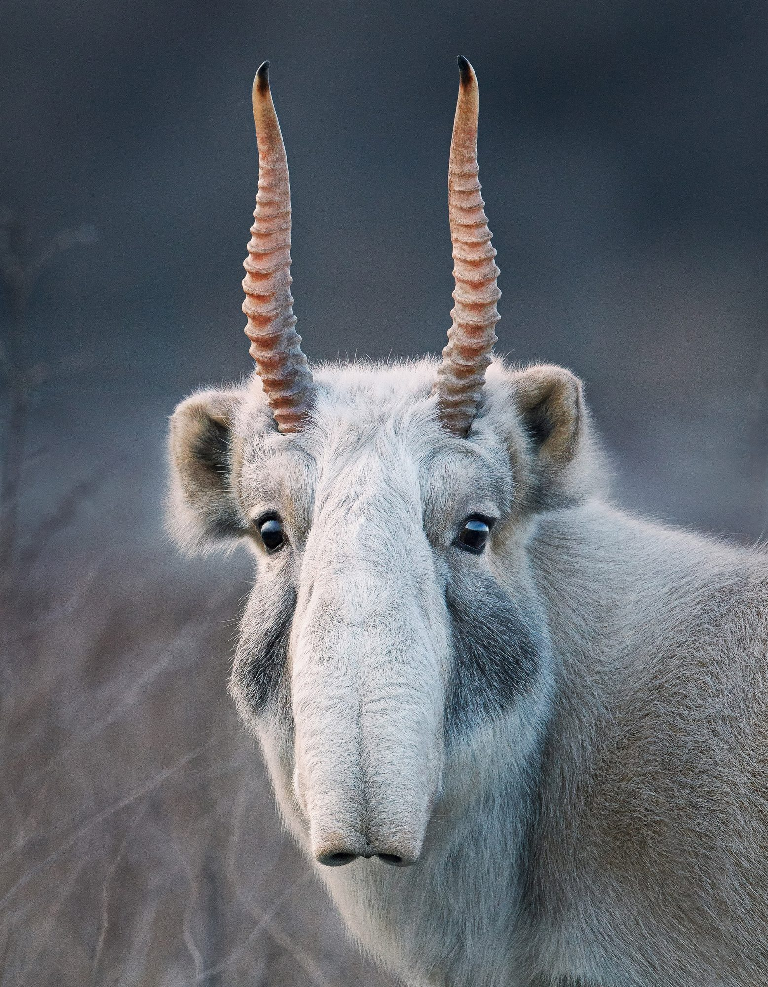
BI3010 structure
Two coordinators
  Deon Roos and Michelle Pinard
    For stats questions: (deon.roos4@abdn.ac.uk)
    For course questions: (m.a.pinard@abdn.ac.uk)
Course structure
  Mondays: Lectures
    From 09:00 to 12:00
  Tuesdays: Practicals / assessments
    From 09:00 to ca. 12:00
  Wednesdays: Lectures
    09:00 to 12:00
  Fridays: Practicals
    From 09:00 to ca. 12:00
We need a course rep – speak with Michelle or Deon if interested

Slide 13
BI3010 Timetable

Slide 14
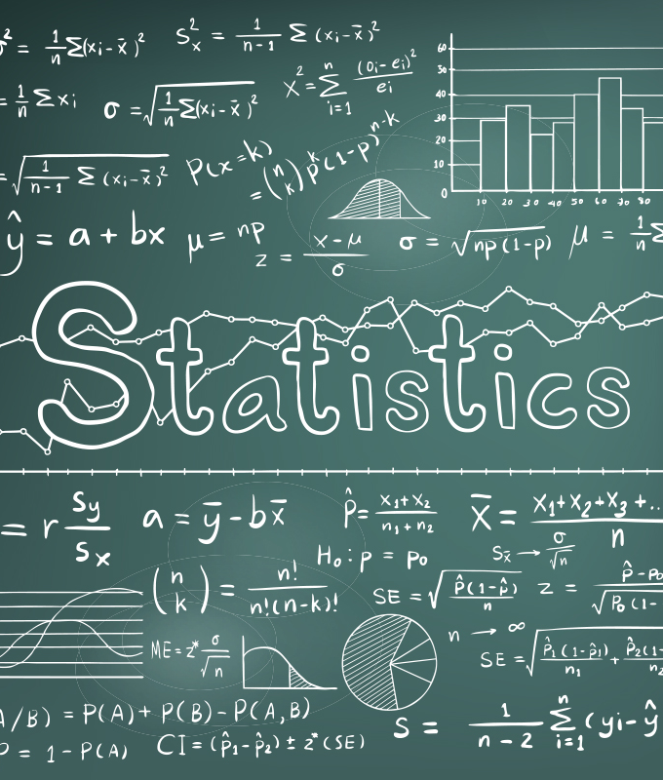
Manage expectations
This course is quantitative
Includes technical information
No expectation that you remember every detail
Instead, focus on the “flow” of logic
Details can always be googled. Understanding cannot.

Slide 15
Aims of the course: Stats in a practical setting
How to use stats to help guide decision making
  “My model suggests that Y occurs in 53% (CI, 45% to 67%) of sites. The options available to resolve this include X and Z.”
Appreciate how stats are crucial to making sense of the world
  “Species A survival increases with X, declines with Y, and has no relationship with Z”
Understand the underlying logic
  “Models estimate a value(s) for a parameter(s). Parameters describe associations between variables.”
Gain some experience in communicating complex stats
  “The model suggests species X benefits under high radiation doses, though there was lots of uncertainty”
Gain some practical experience using stats
  “I can use method X, give me a job”
    Stats = ML/AI/data science etc.
Be critical of published science
  “Although Jones et al. suggest trophic cascades are ubiquitous, the data used is biassed given the sampling design and the analysis was overly simplistic”

Slide 16
Assessments

